Slide 1

Welcome to year 6
Richard Whitehead class

Slide 2
The team working with your child
Mr Hall
Miss Stray
Mrs Lodge
Mr Gough
Miss Wise
Miss Kendal
Mrs Parry

Slide 3
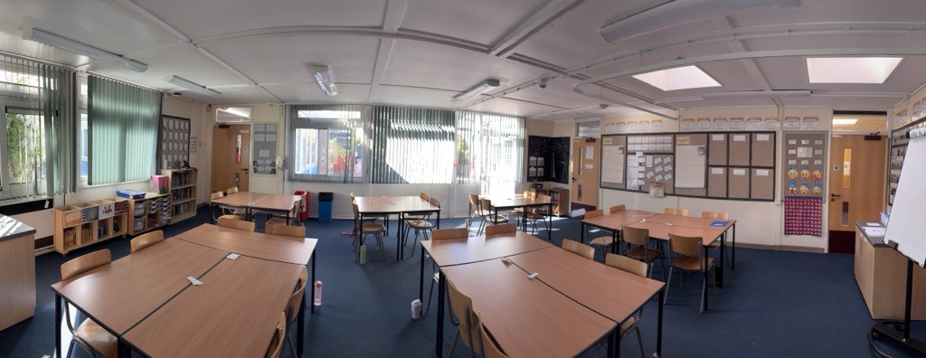
Your child’s learning environment

Slide 4
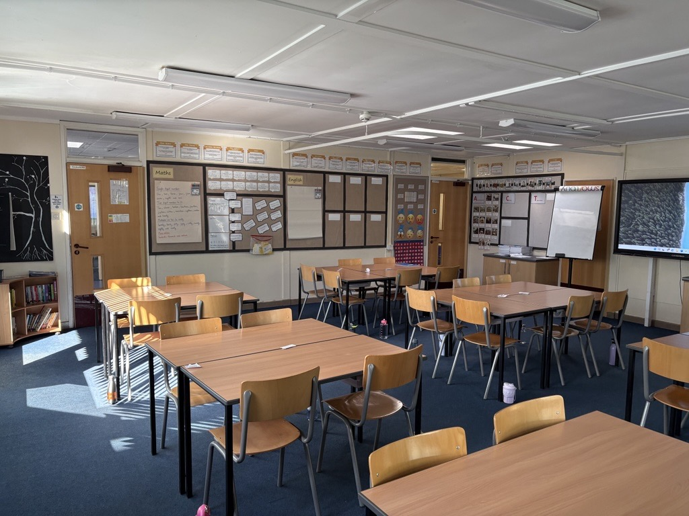
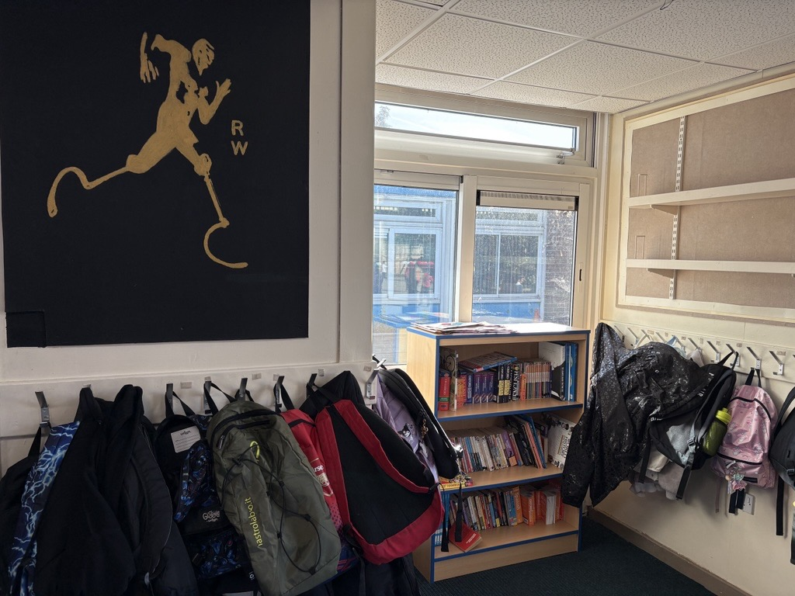
Your child’s learning environment contd.

Slide 5
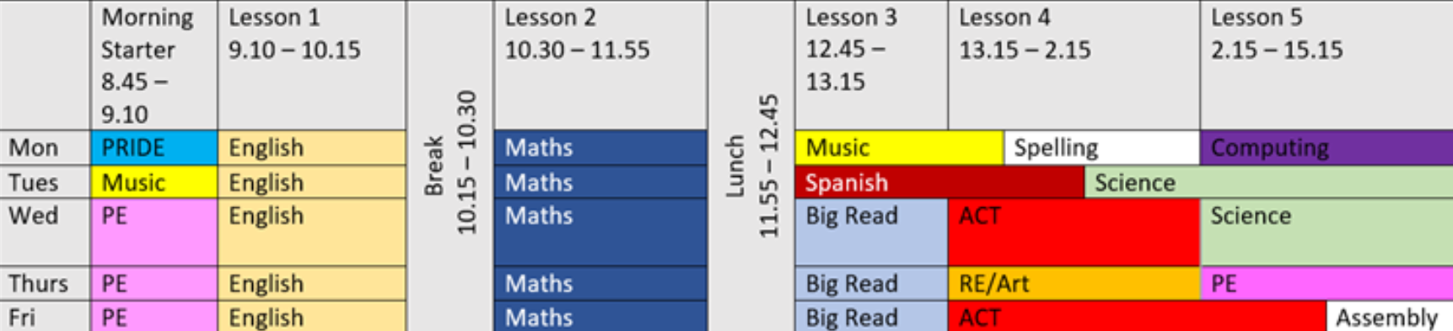
Timetable

Slide 6
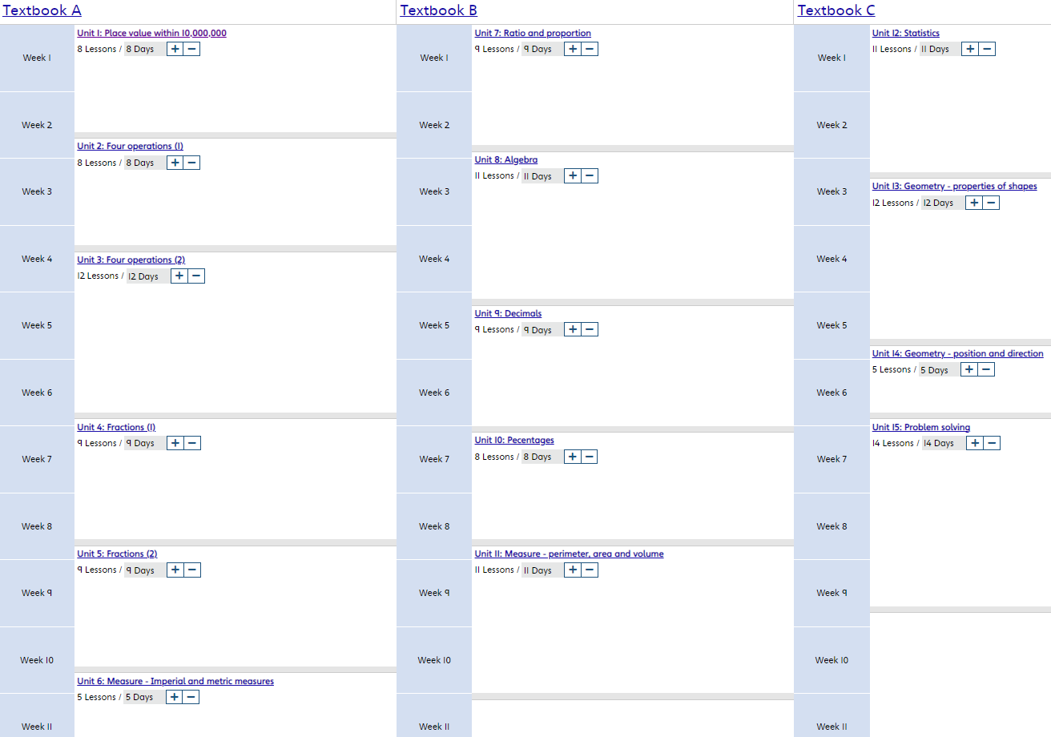


Slide 7
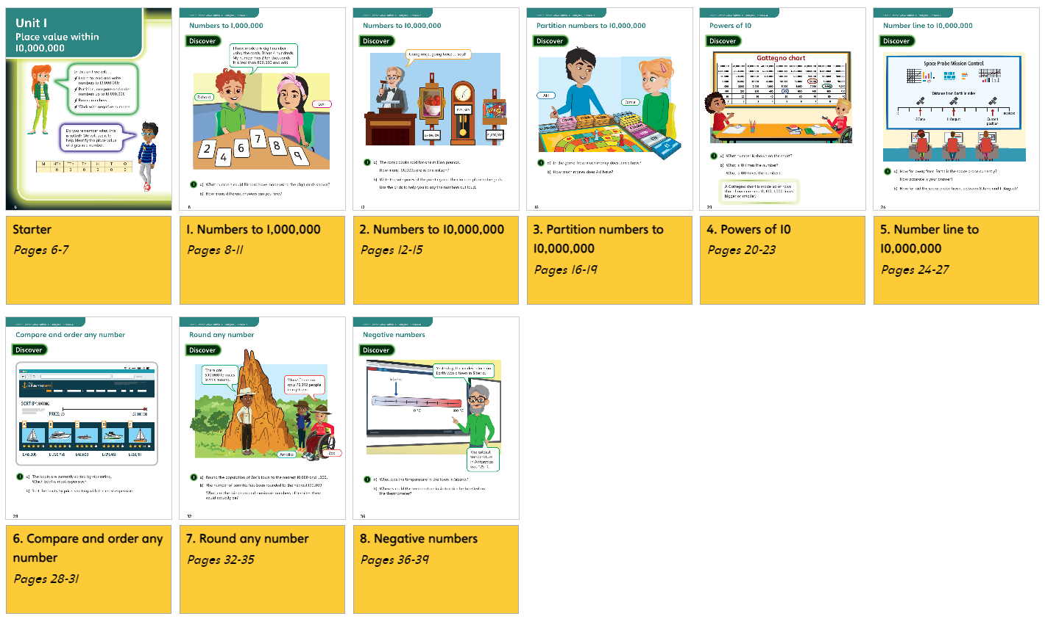

Slide 8
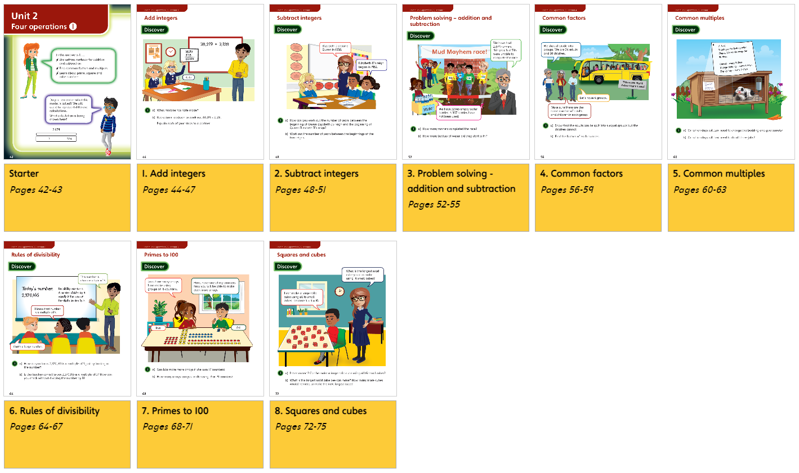

Slide 9
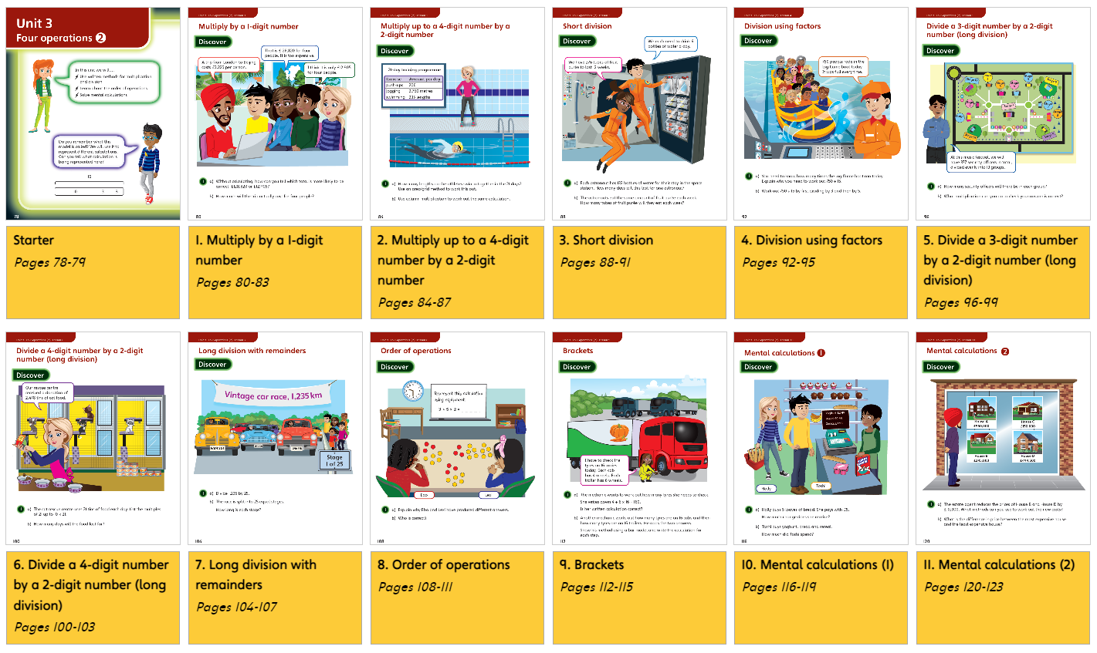

Slide 10
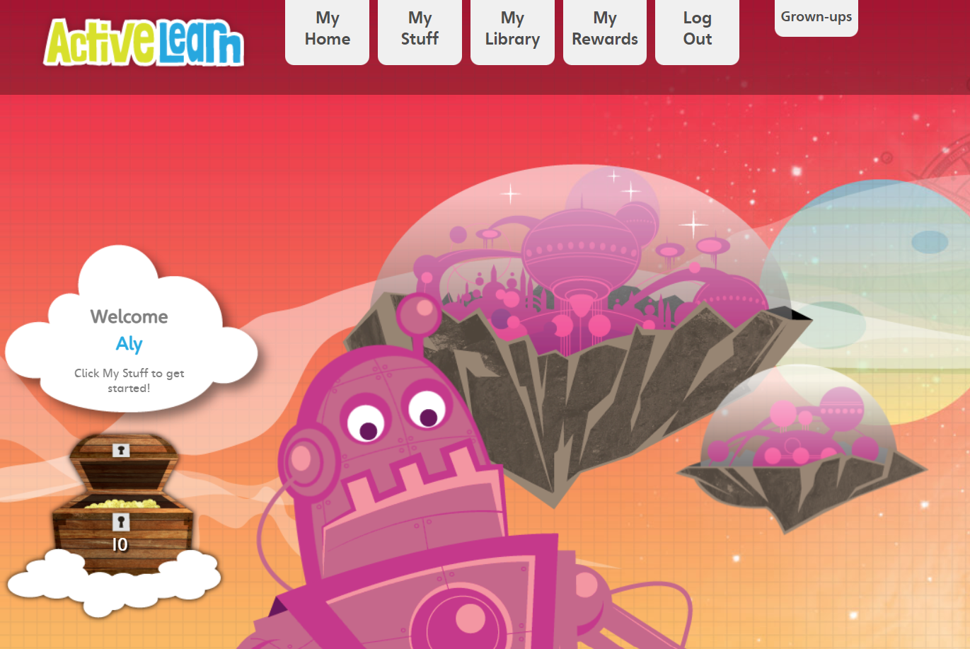


Maths learning at home
Active learn – www.activelearnprimary.co.uk/login
Times Table Rockstars – download the app
Log –in’s will follow once they have been introduced to the children

Slide 11

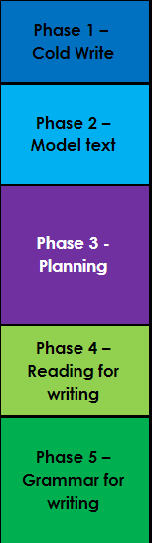
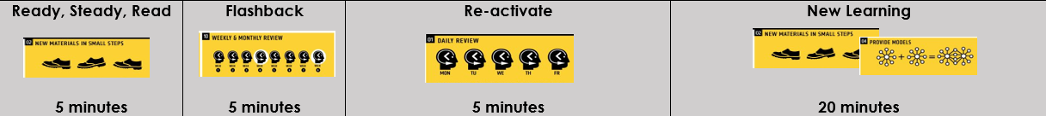

English
Prediction
Vocabulary
Retrieval questions
Chronology, true or false, fact or opinion questions
Clarifying
Summarisation
Inference

Slide 12
English learning at home
Home/school reading
Writing and reading based termly home works to be sent out on the termly homework sheet
Spellings

Slide 13
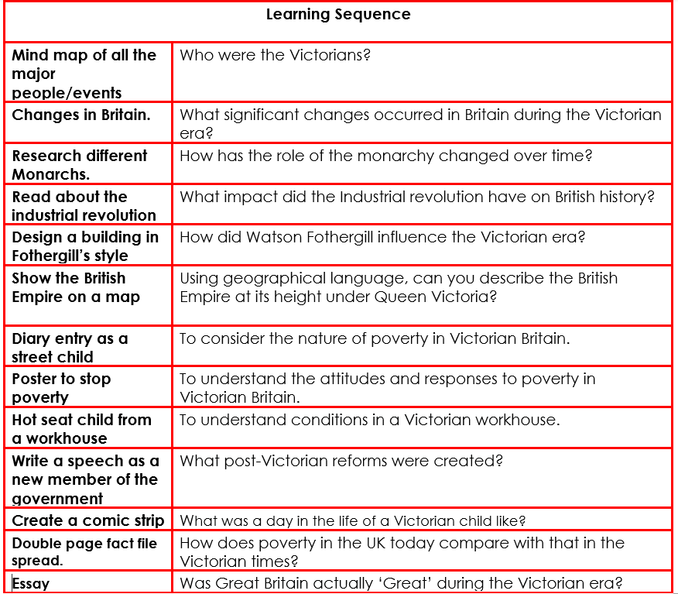
ACT

Slide 14
General expectations
Behaviour – arbor points
PRIDE – weekly and termly assemblies
Attendance – we learn a lot in a day!
Timekeeping – we start learning straight away so please don’t be late
PE is on Thursday. Your child can wear clothes suitable for PE e.g. black trainers / black tracksuit bottoms or leggings and polo shirt.

Slide 15

Class Dojo – communication between school and parents
Non-urgent messages on Dojo – urgent messages call
the office
Information from school
Homework
Upcoming events
Updates regarding learning in the classroom

