Slide 1

First Days at school.
Simple words and phrases

Slide 2
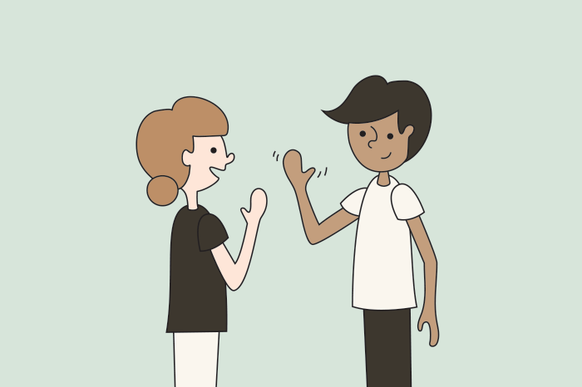

hello
How are you?
I am
ill

Slide 3

hello
How are you?
I am
sad

Slide 4

hello
How are you?
I am
tired

Slide 5

hello
How are you?
I am
cold

Slide 6

hello
How are you?
I am
hot

Slide 7

hello
How are you?
I am
okay

Slide 8

hello
How are you?
I am
hungry

Slide 9

hello
How are you?
happy
I am

Slide 10

yes
Yes, I am happy.

Slide 11


no
No, I am not happy.

Slide 12

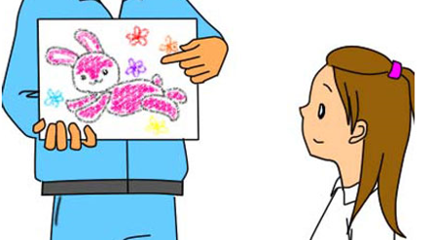
look
Look at the picture.

Slide 13
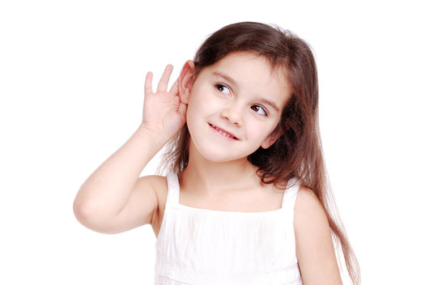
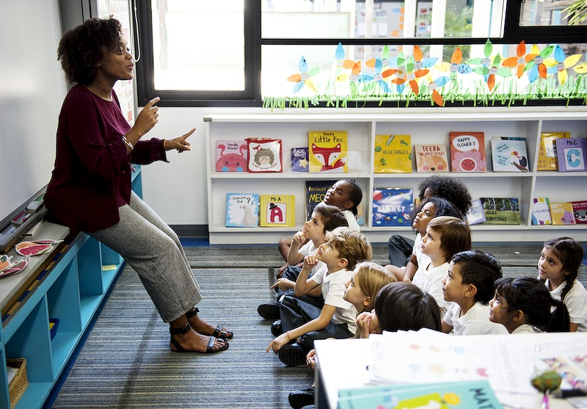
listen
Listen to the teacher.

Slide 14
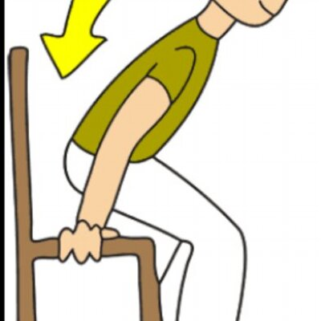
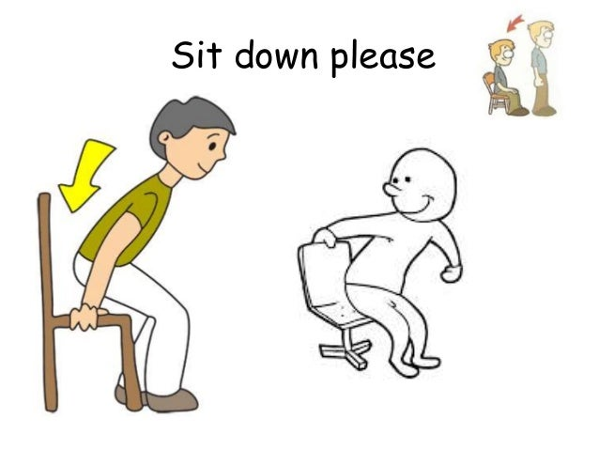
sit down
Sit down please.

Slide 15
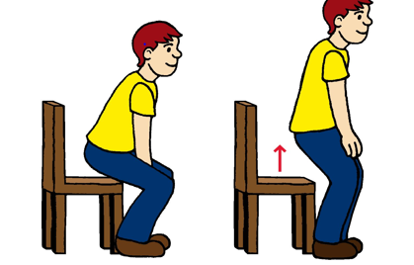
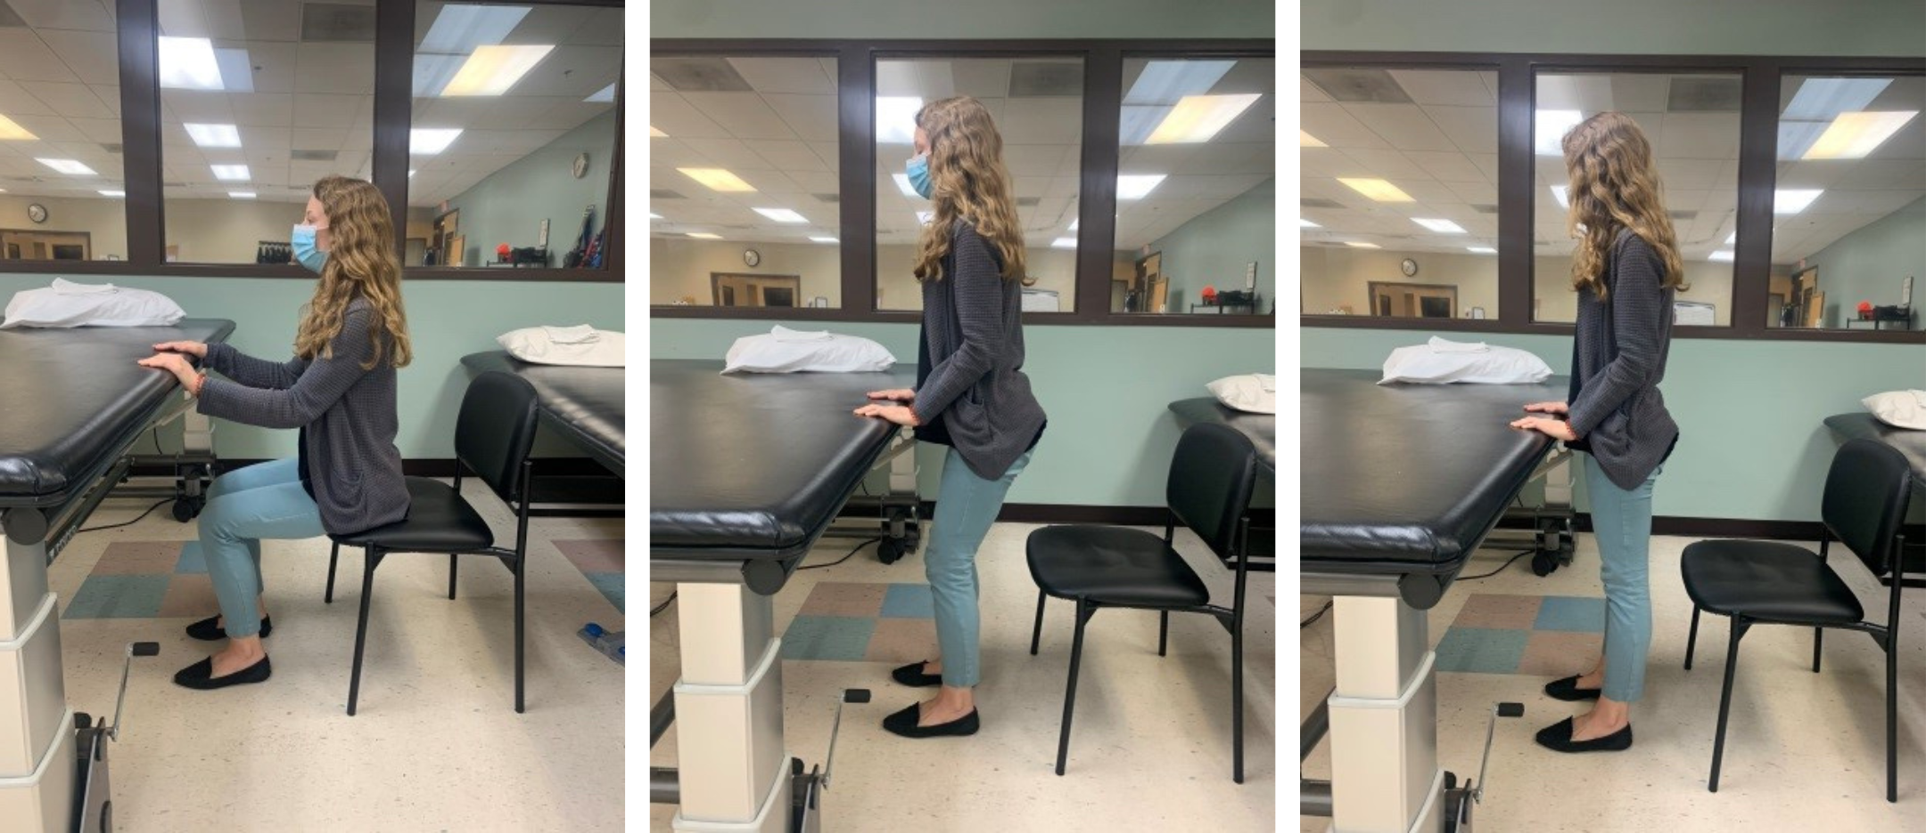
stand up
Stand up please.

Slide 16


well done
Well done, you have finished!

Slide 17
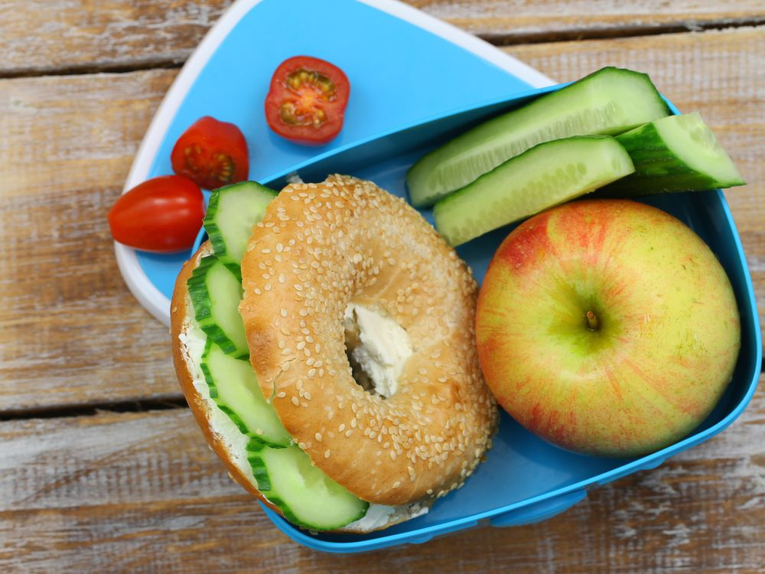
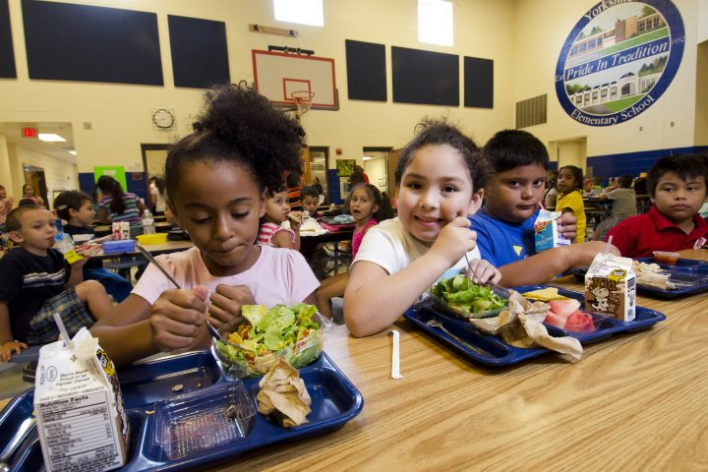
lunch time
It is time for lunch!

Slide 18

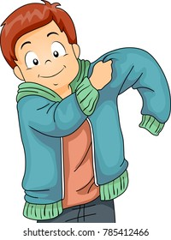
coat
Please put your coat on!

Slide 19

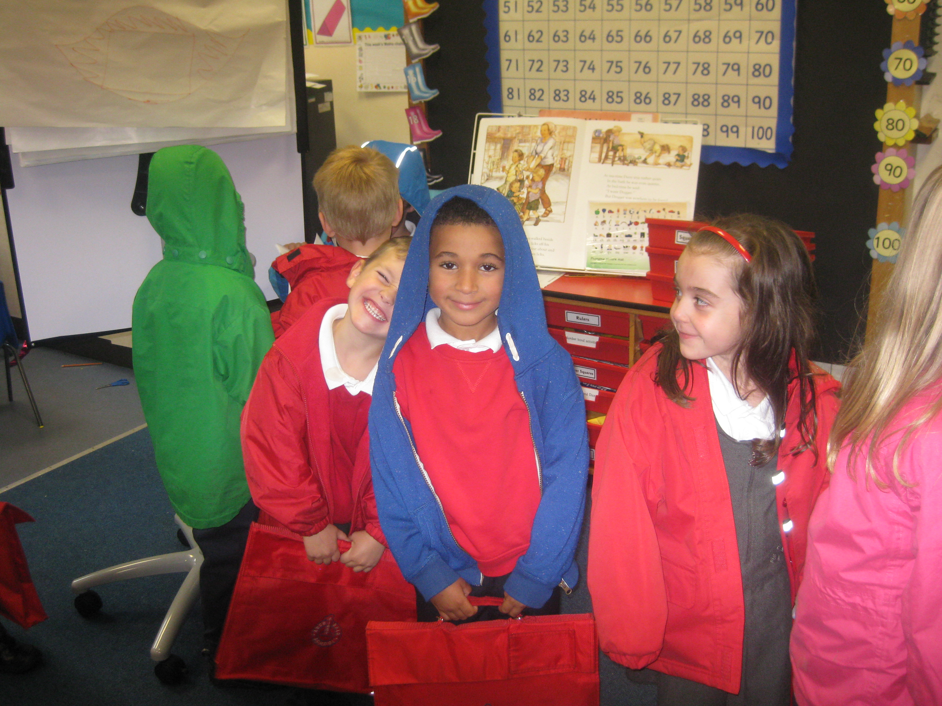
home time
It is home time!

