Slide 1

Classroom objects
Session 3

Slide 2
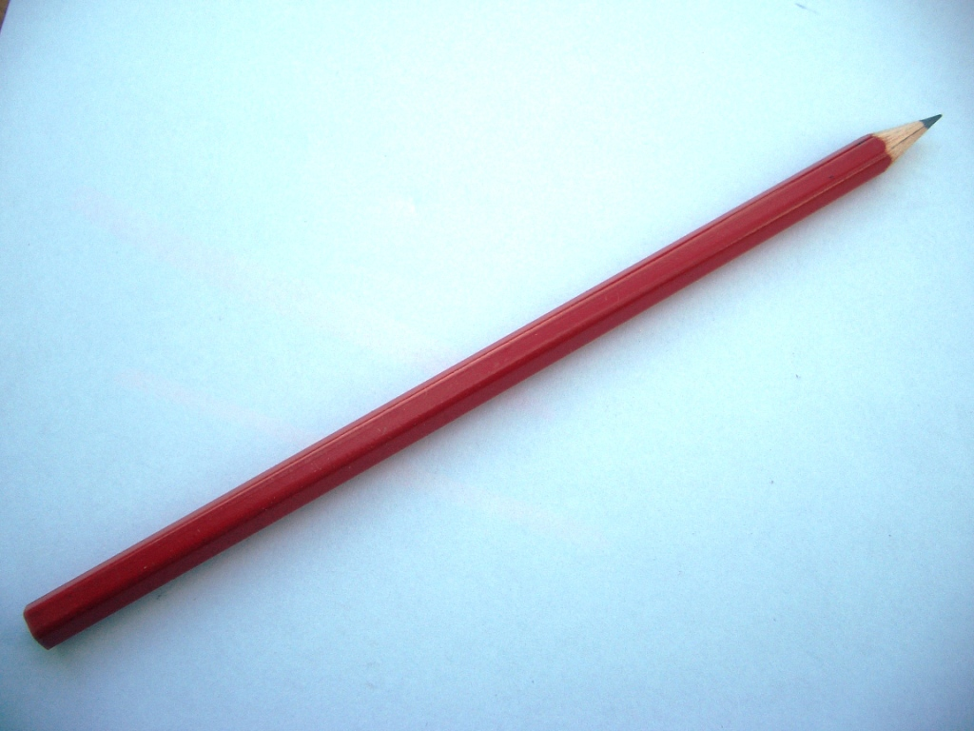
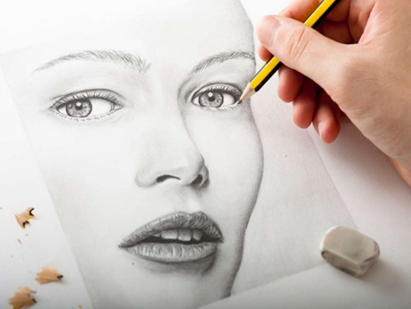
a pencil
I can draw with a pencil.

Slide 3
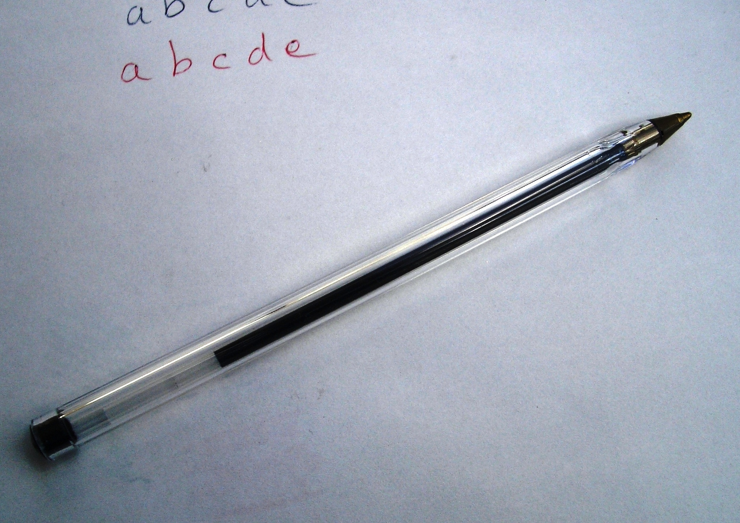
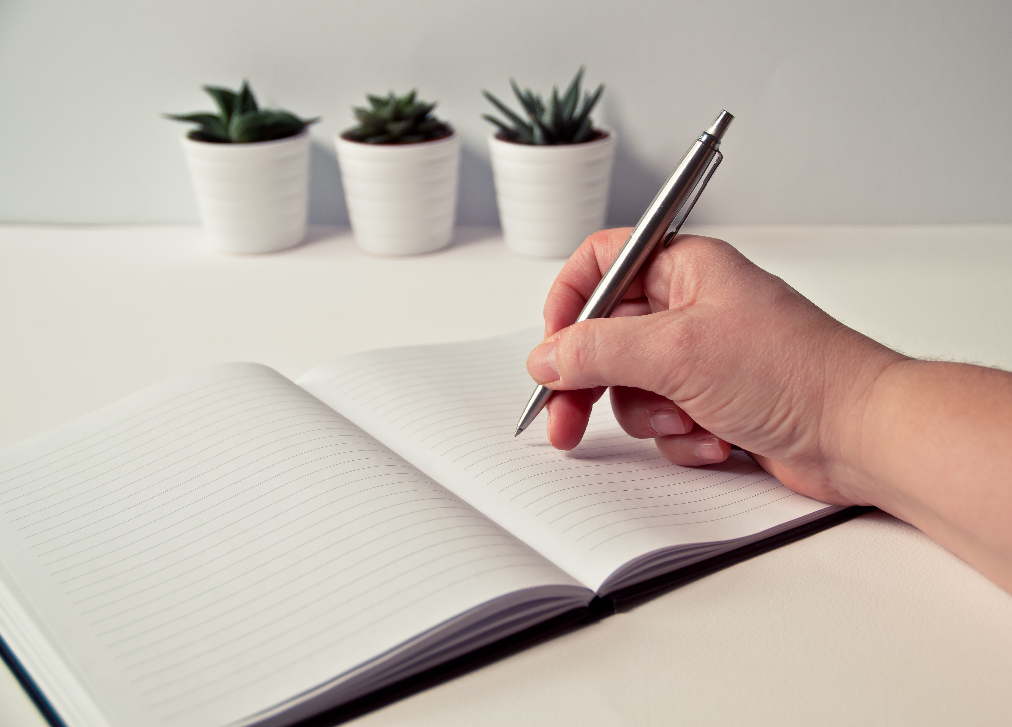
a pen
I can write with a pen.

Slide 4
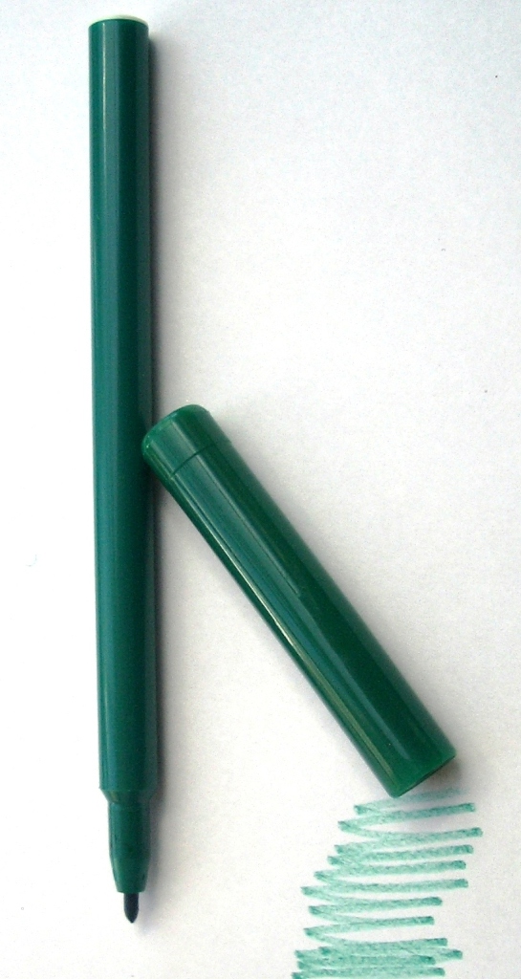
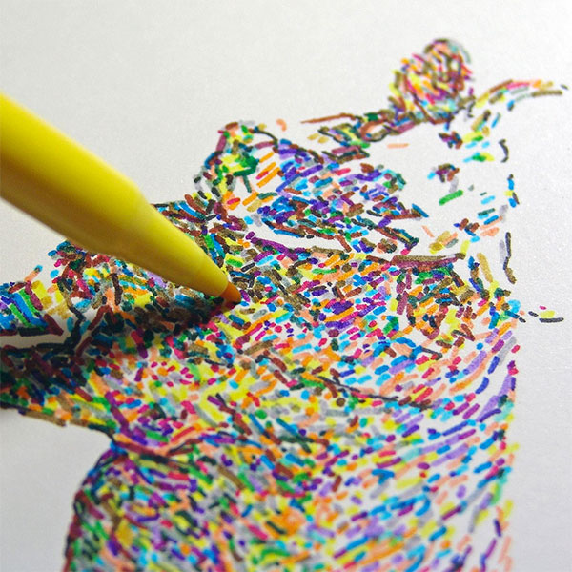
a felt tip pen
I can colour with a felt tip pen.

Slide 5
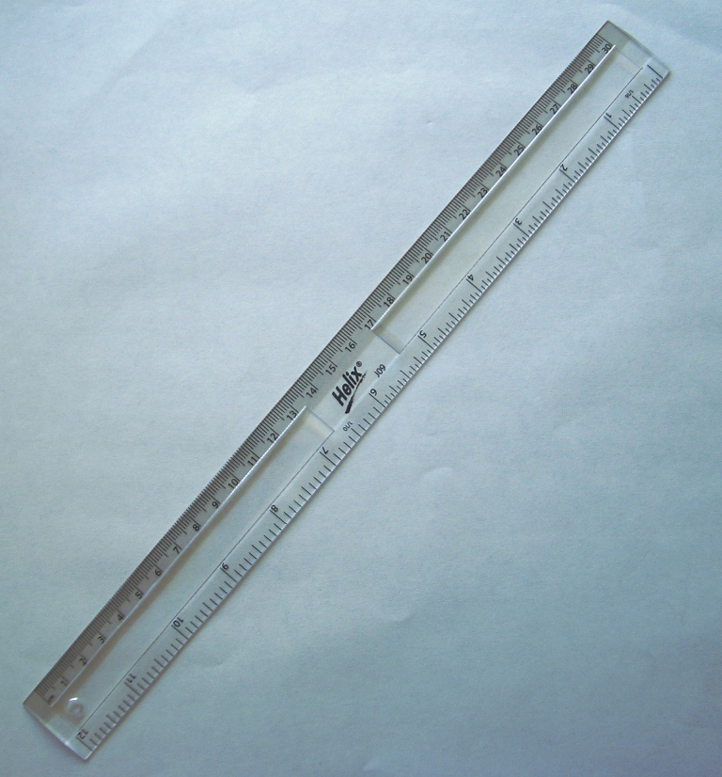
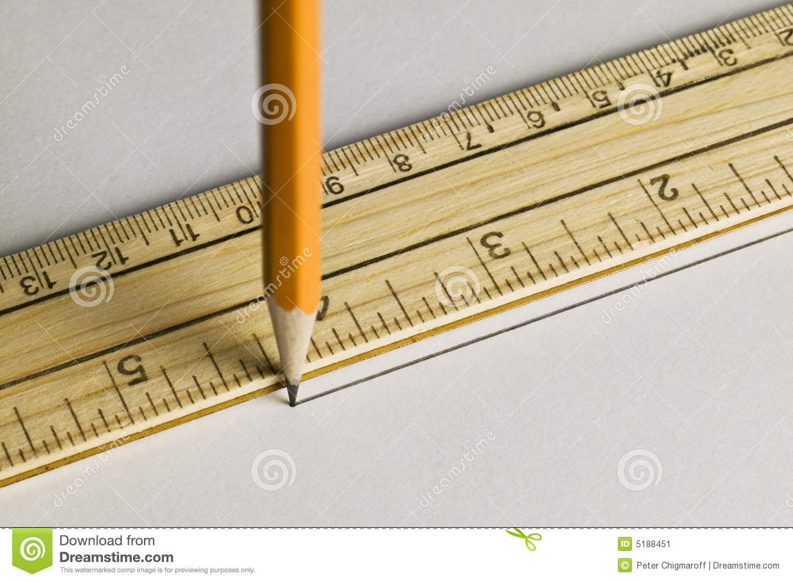
a ruler
I can draw a straight line with a ruler.

Slide 6
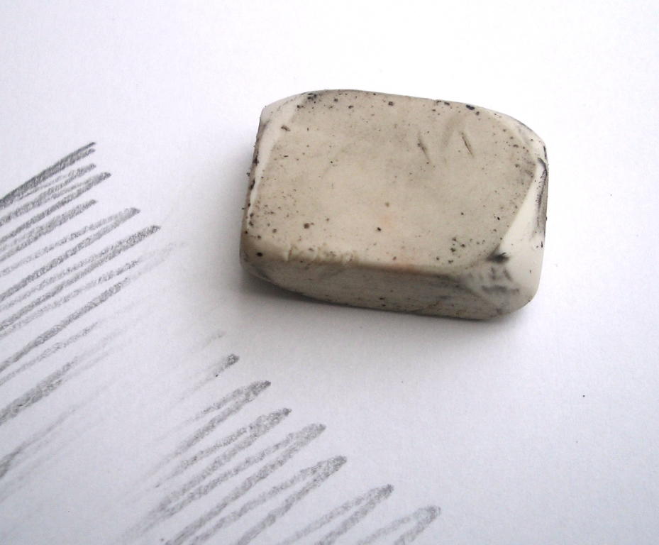
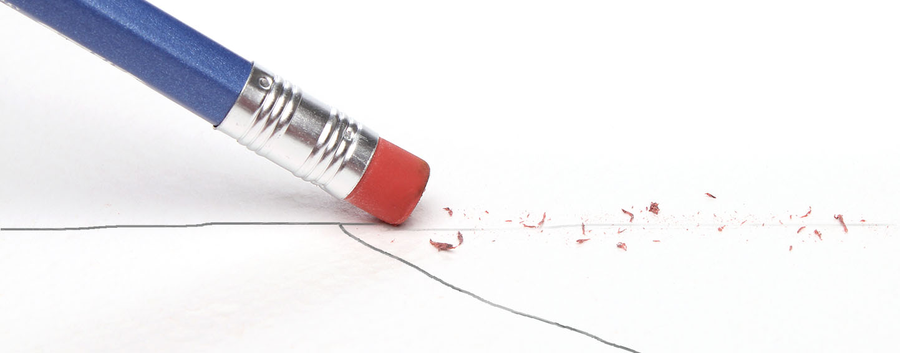
a rubber
I can rub out with a rubber.

Slide 7
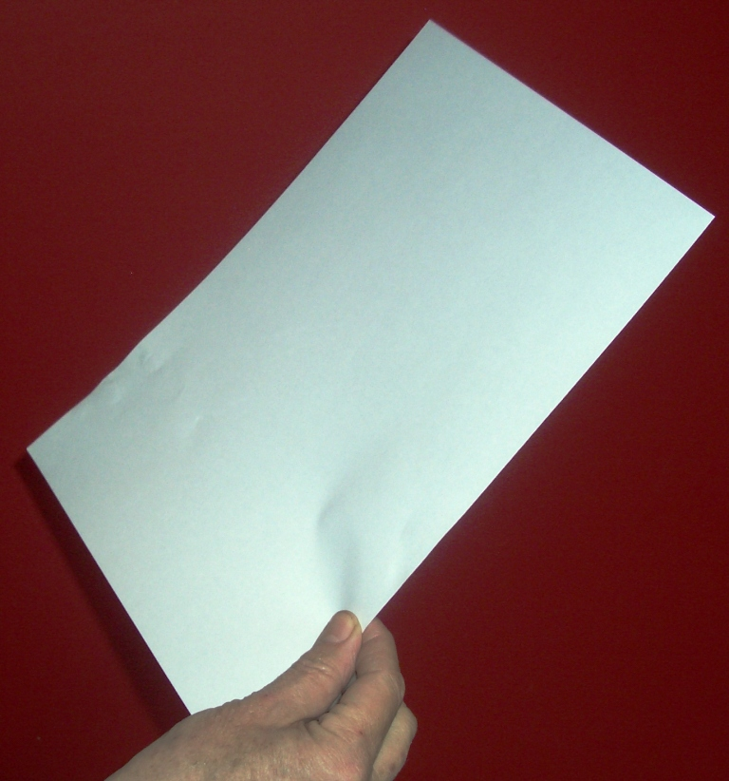
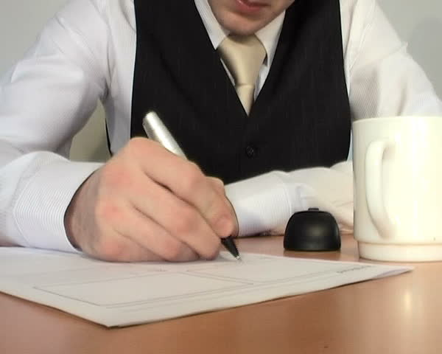
a piece of paper
I write on a piece of paper.

Slide 8
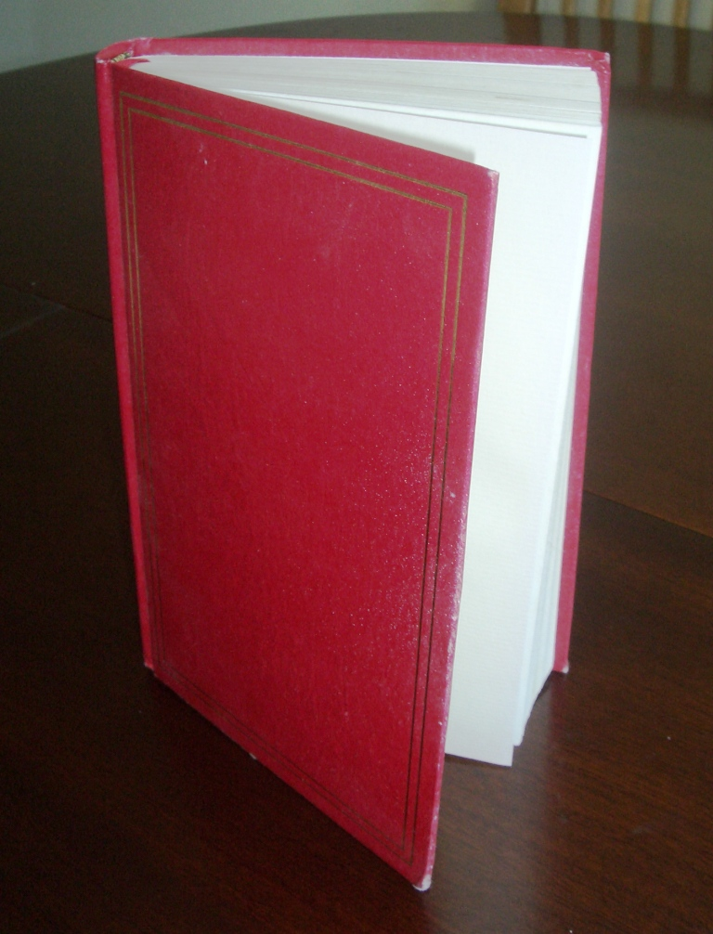
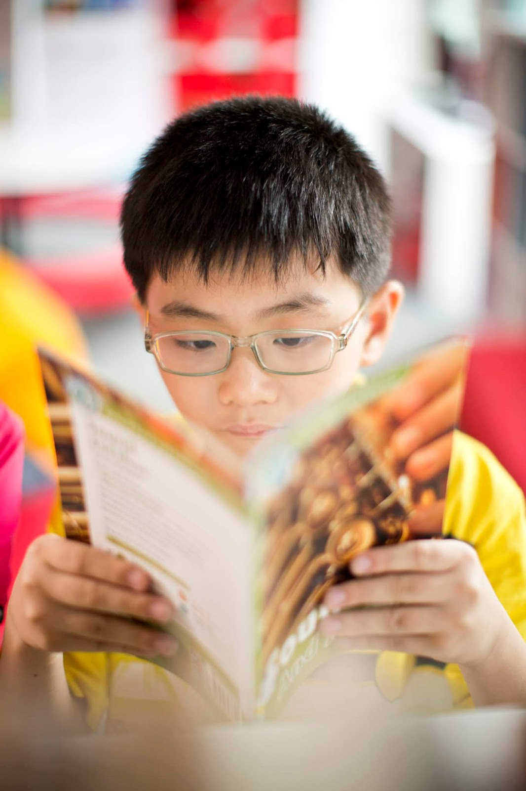
a book
I can read a book.
This Photo by Unknown Author is licensed under CC BY-SA-NC

Slide 9
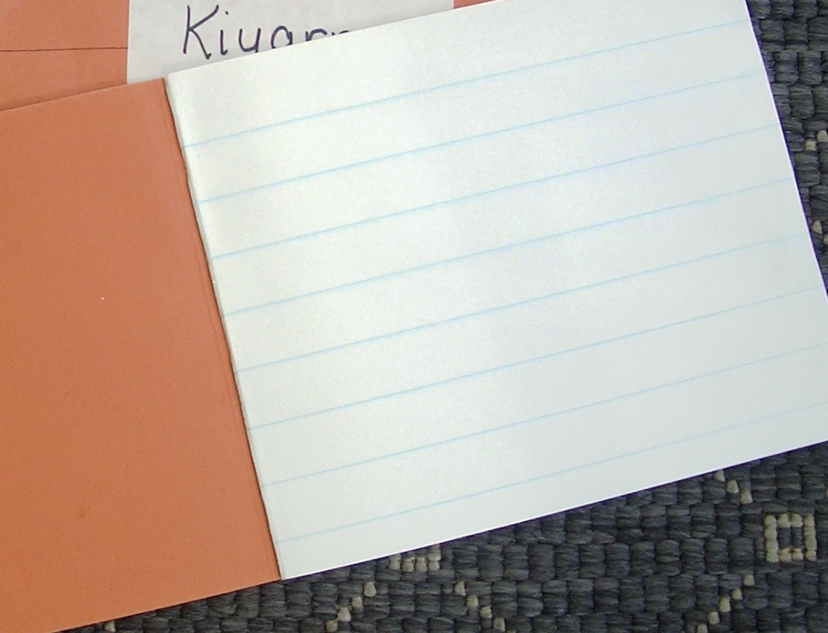
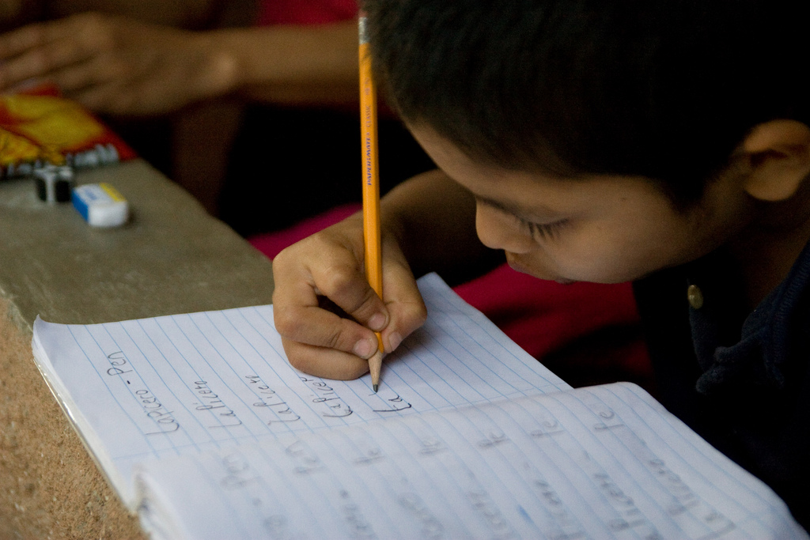
an exercise book
I can write in an exercise book.
This Photo by Unknown Author is licensed under CC BY-SA

Slide 10
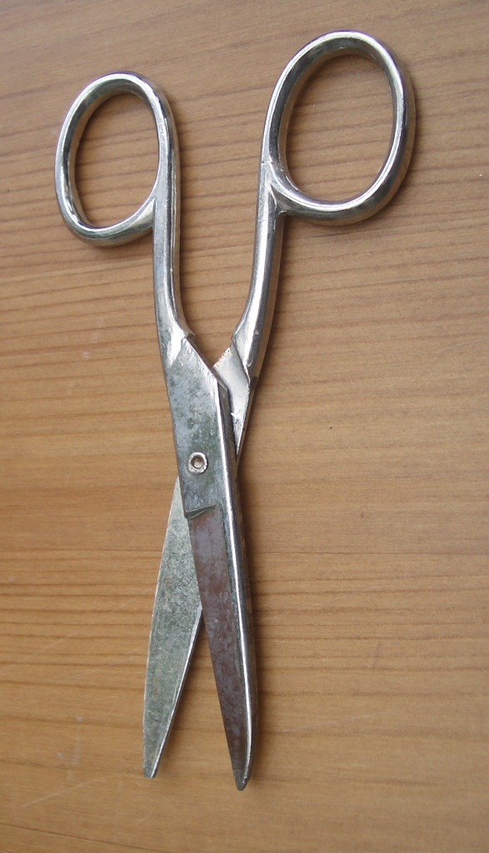
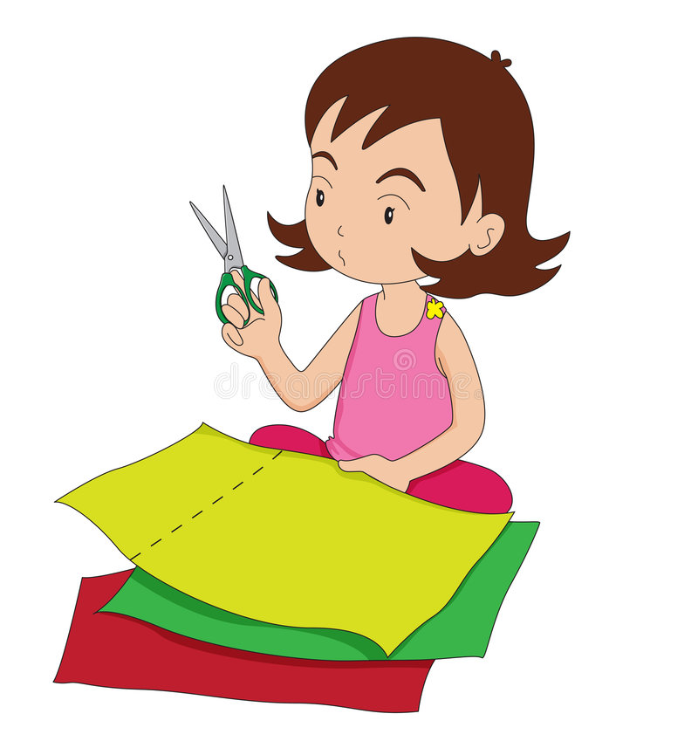
a pair of scissors
I cut with a pair of scissors.

Slide 11
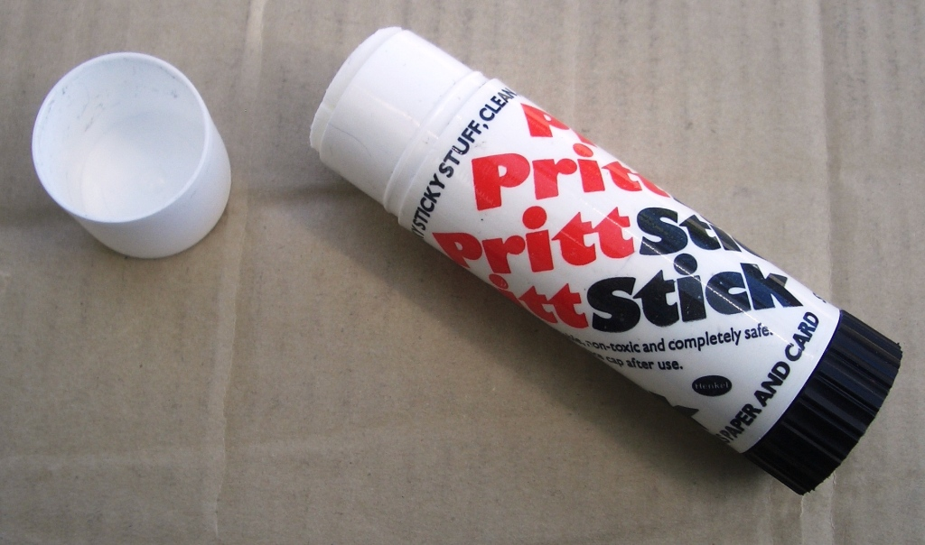
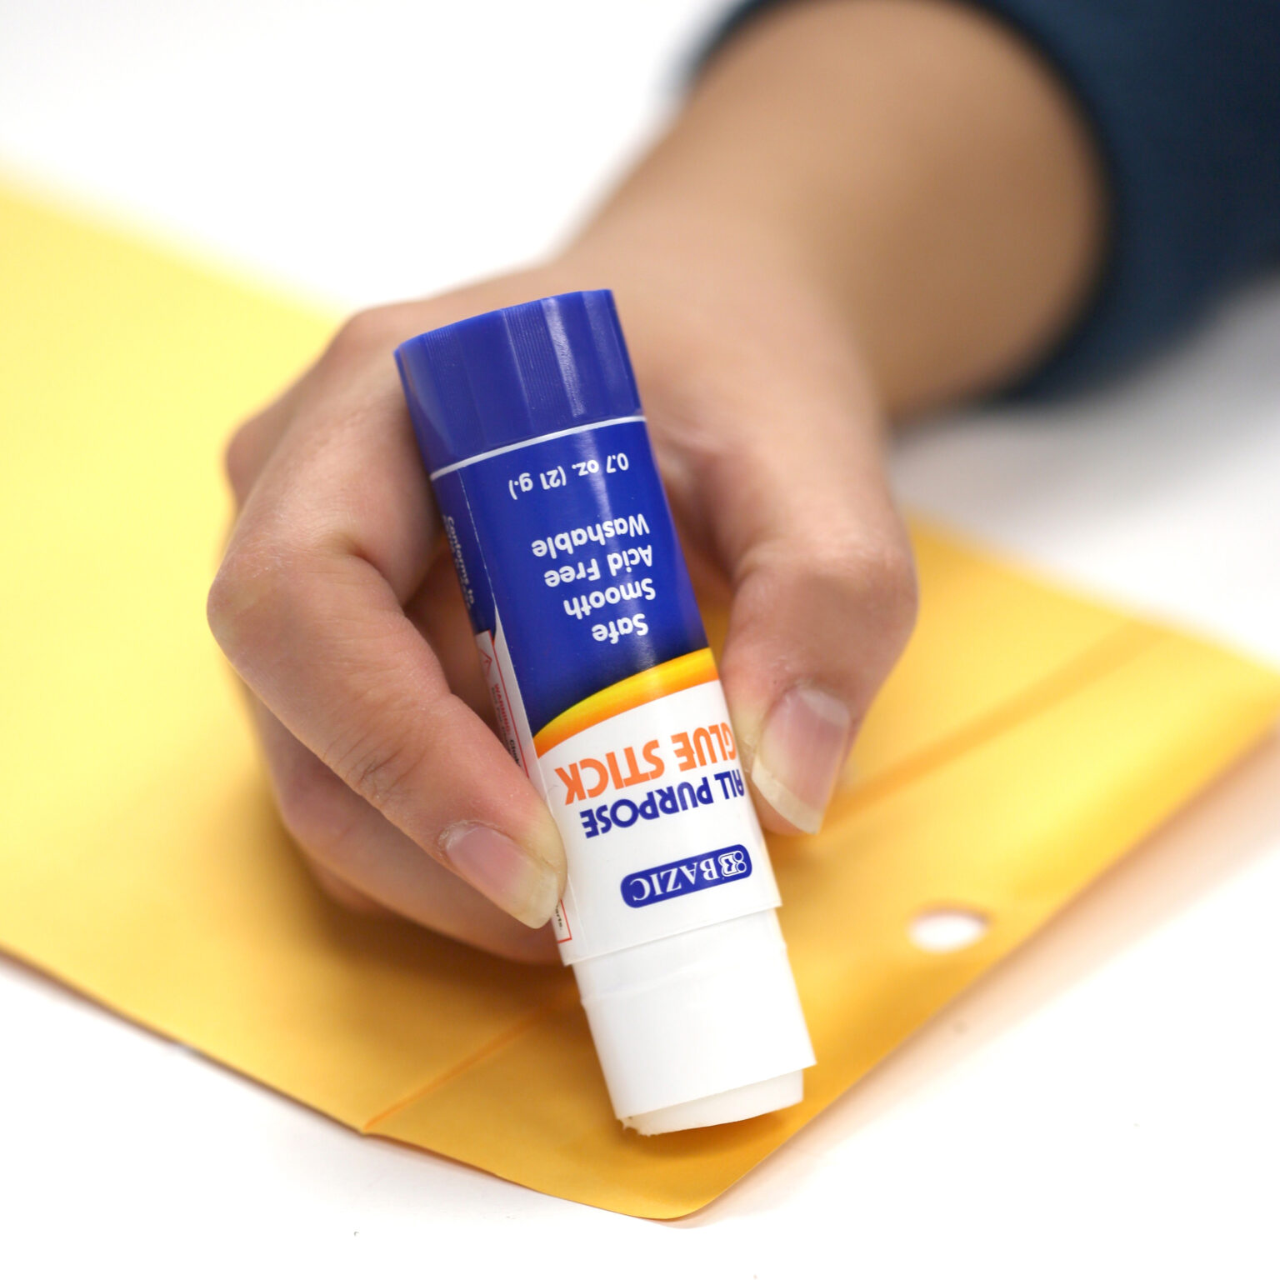
a glue stick
I can glue with a glue stick.

Slide 12
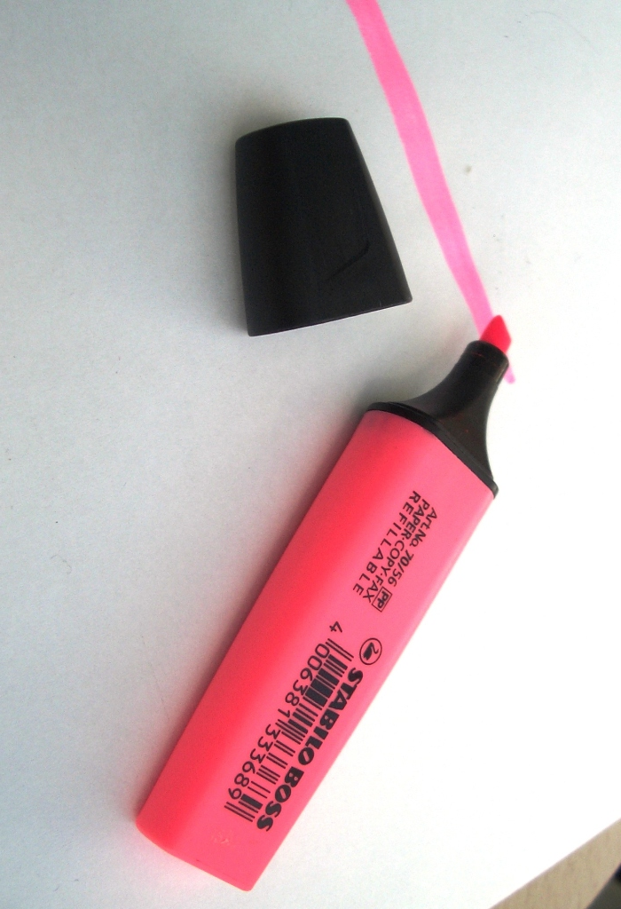

a highlighter pen
I can highlight words.

Slide 13
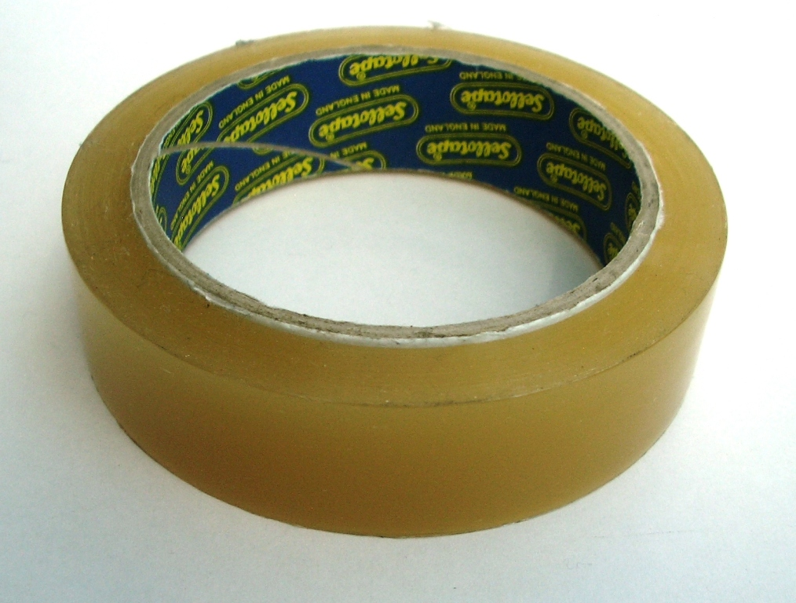
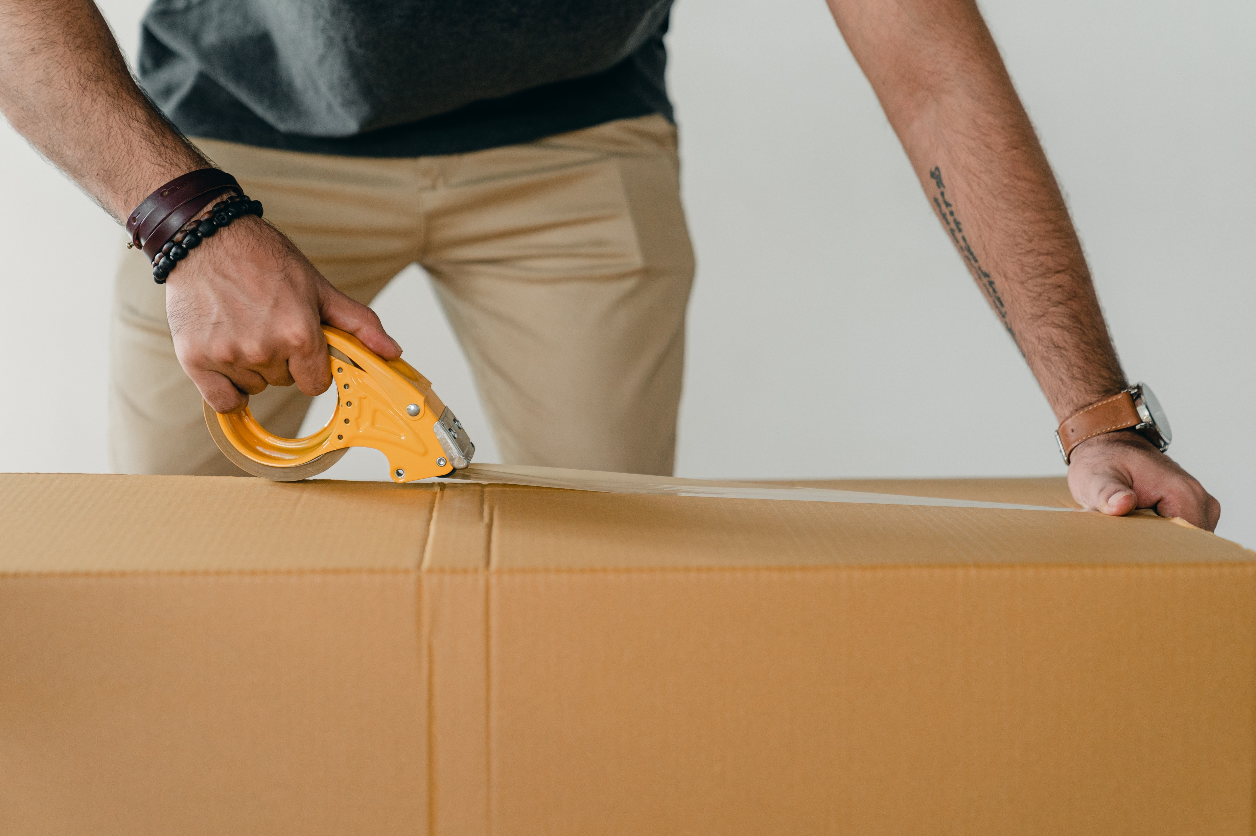
a roll of sellotape
I can use sellotape to stick things together.

Slide 14
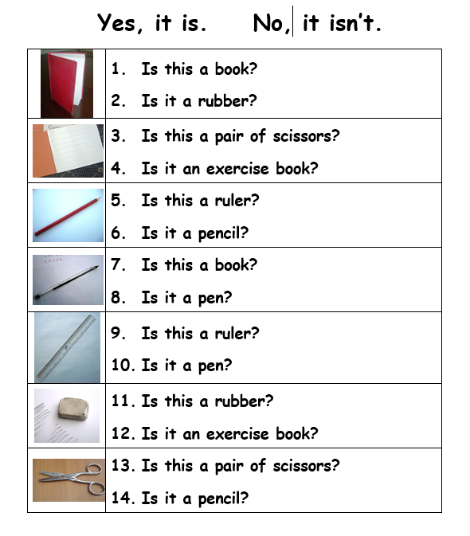

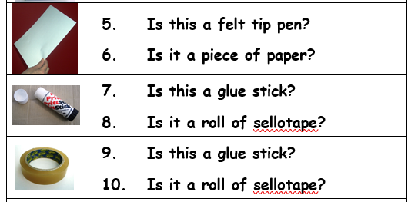

Is this a book? Yes, it is.
Is this a rubber? No, it isn’t

Slide 15
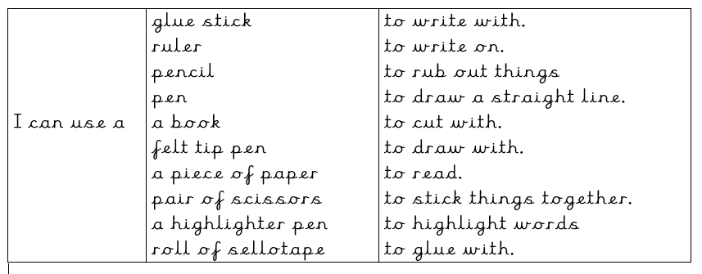
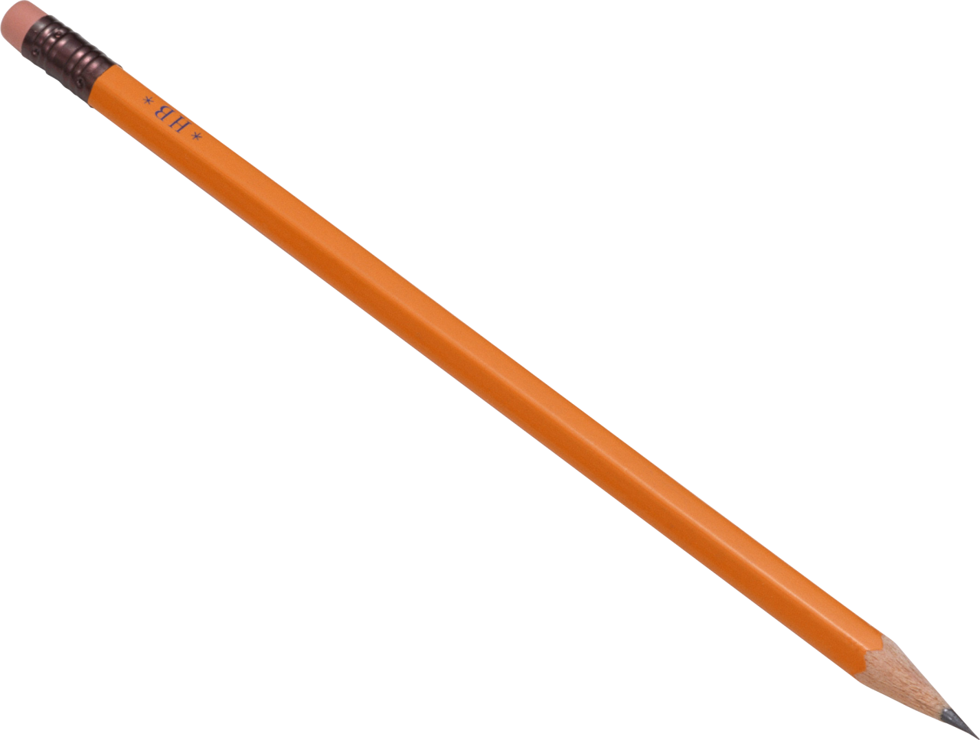
I can use a pair of scissors to cut with.

