Slide 1


BODY PARTS
EAL SUPPORT

Slide 2
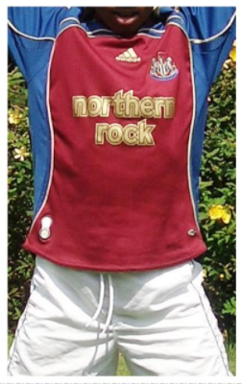
a body
This is a body.

Slide 3
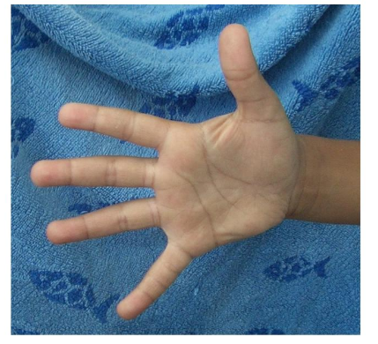
a hand
This is a hand.

Slide 4
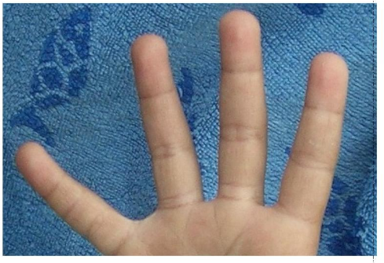
some fingers
These are fingers.

Slide 5
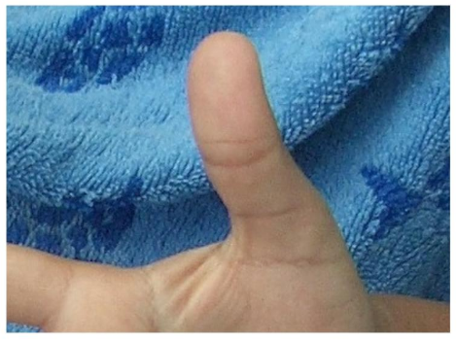
a thumb
This is a thumb.

Slide 6
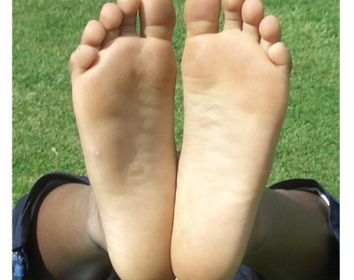
two feet
These are feet.

Slide 7
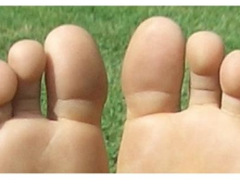
some toes
These are toes.

Slide 8
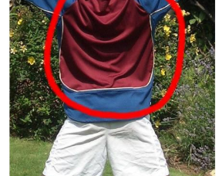
a back
This is a back.

Slide 9
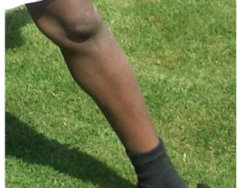
a leg
This is a leg.

Slide 10
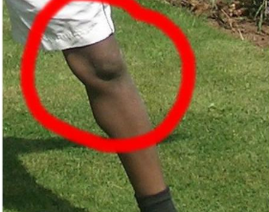
a knee
This is a knee.

Slide 11
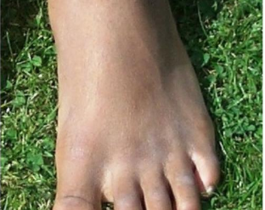
a foot
This is a foot.

Slide 12
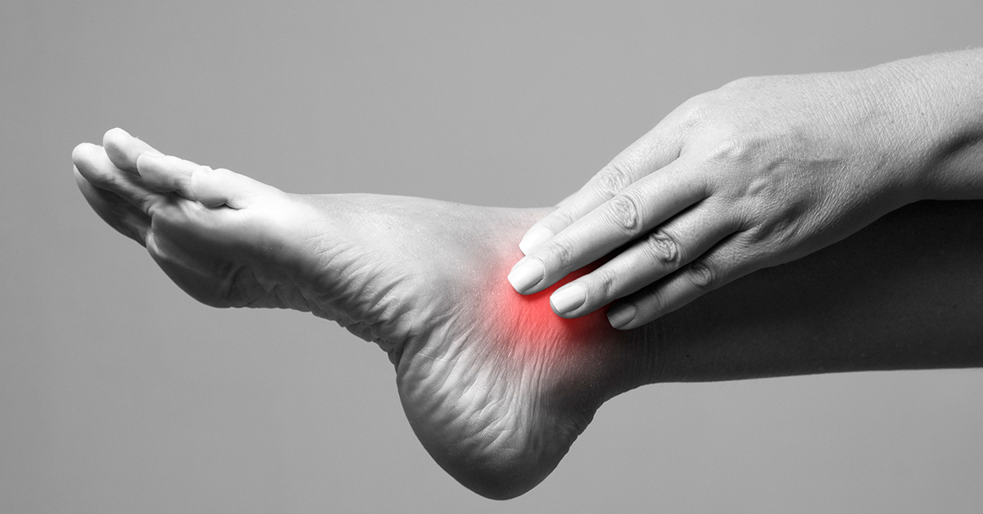
an ankle
This is an ankle.

Slide 13
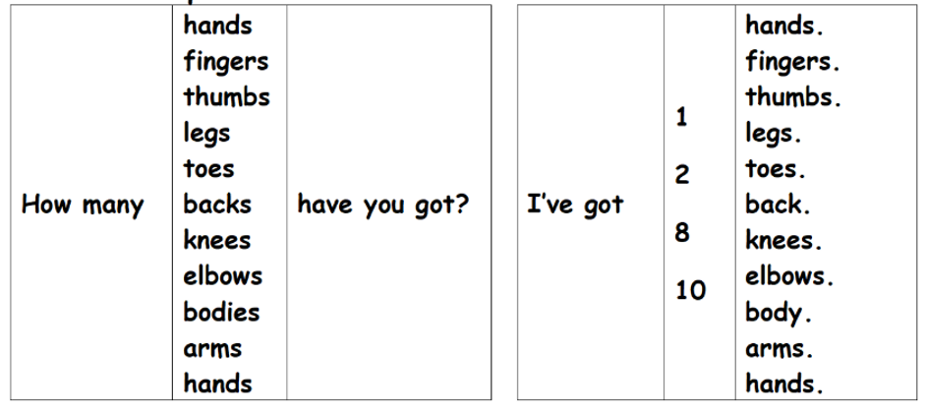

Slide 14
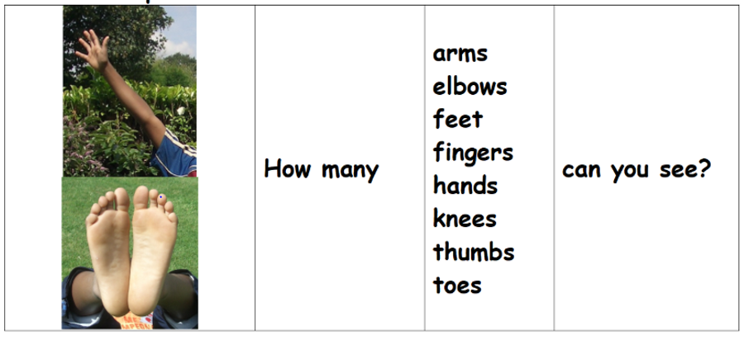

Slide 15

FACE PARTS
EAL SUPPORT

Slide 16
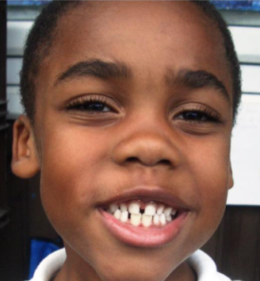
a face
This is a face.

Slide 17
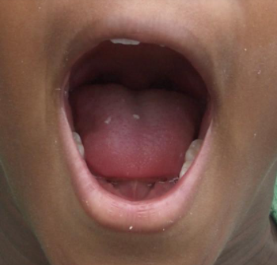
a mouth
This is a mouth.

Slide 18
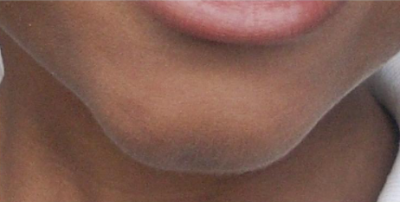
a chin
This is a chin.

Slide 19
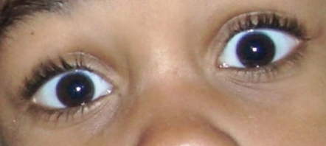
some eyes
These are eyes.

Slide 20
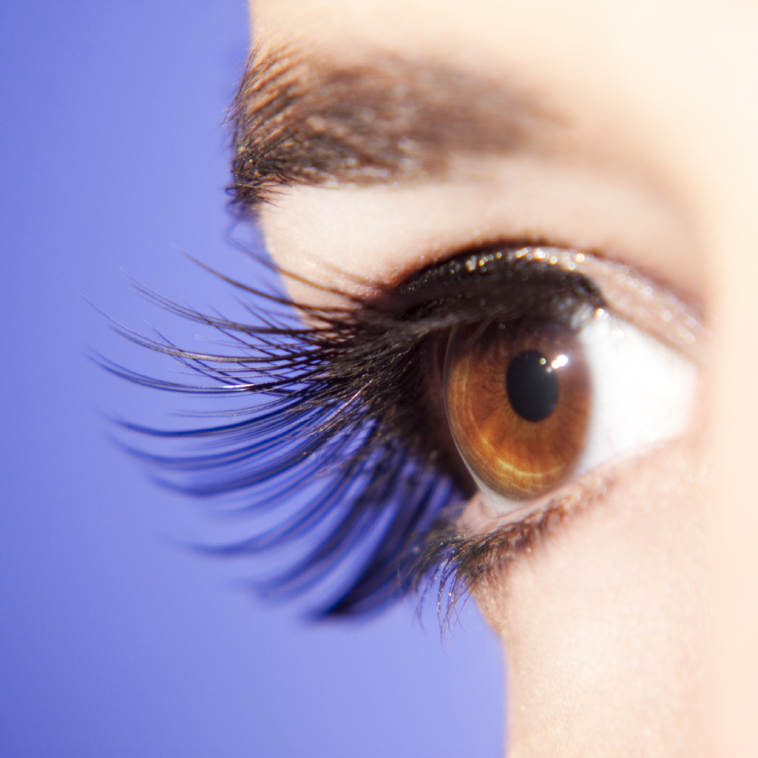
some eyelashes
These are eyelashes.

Slide 21

some eyebrows
These are eyebrows.

Slide 22
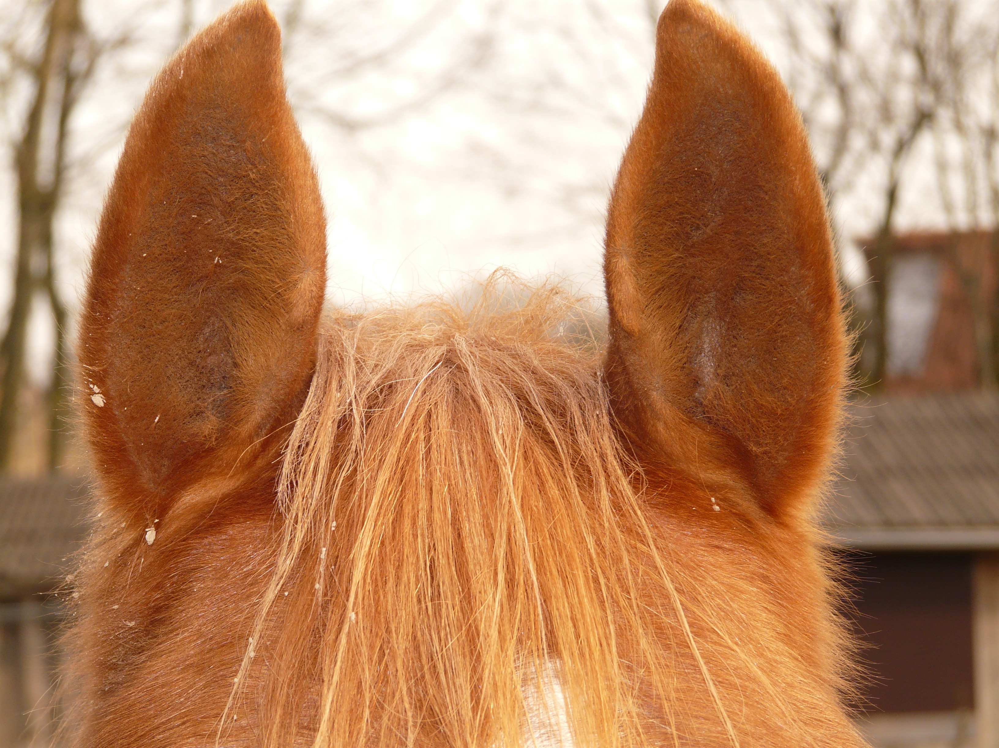
some ears
These are ears.

Slide 23
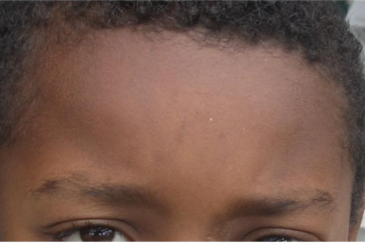
a forehead
This is a forehead.

Slide 24
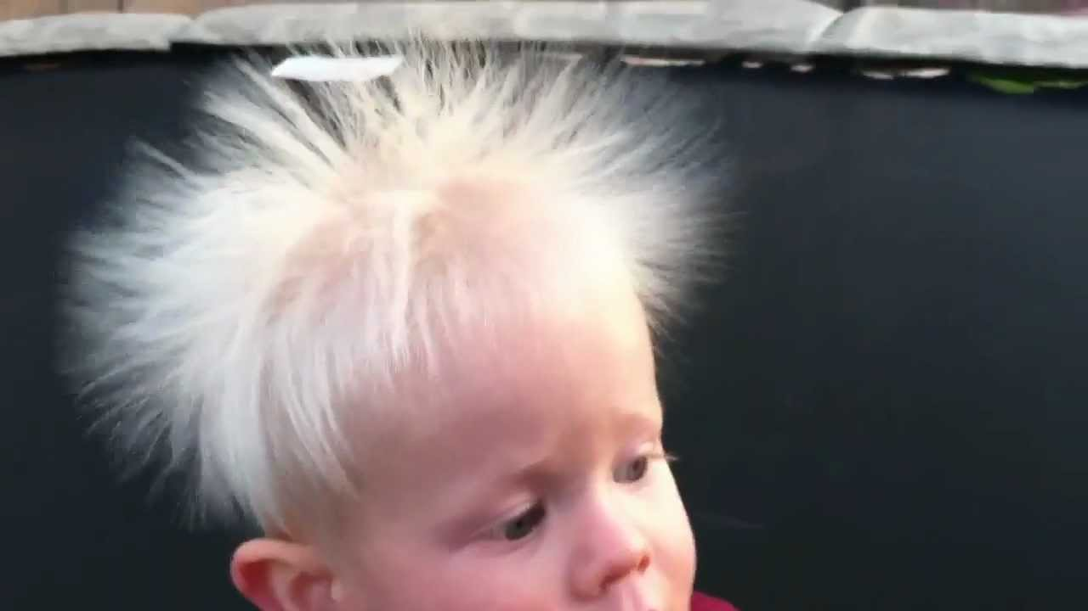
some hair
This is hair.

Slide 25
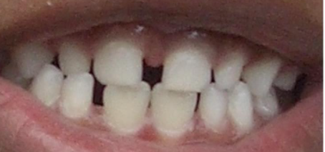
some teeth
These are teeth.

Slide 26
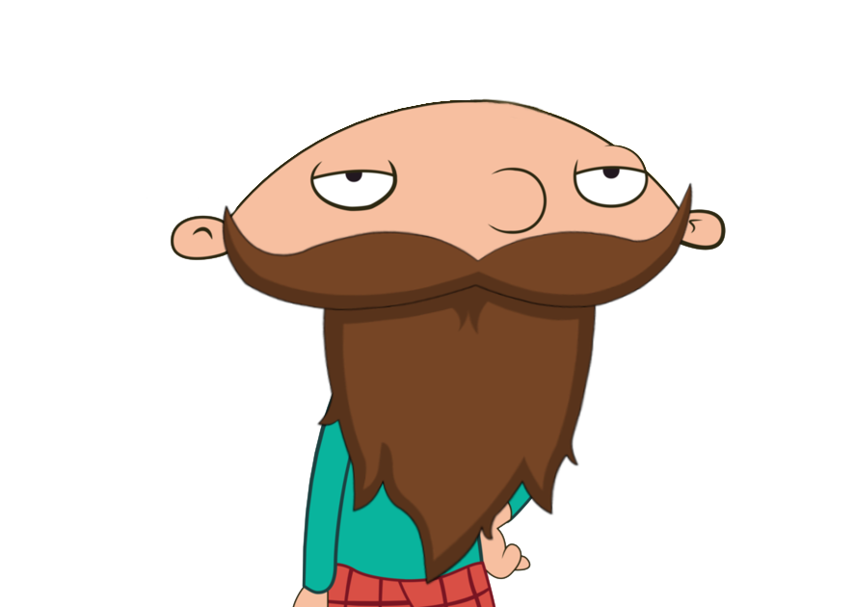
a beard
This is a beard.

Slide 27
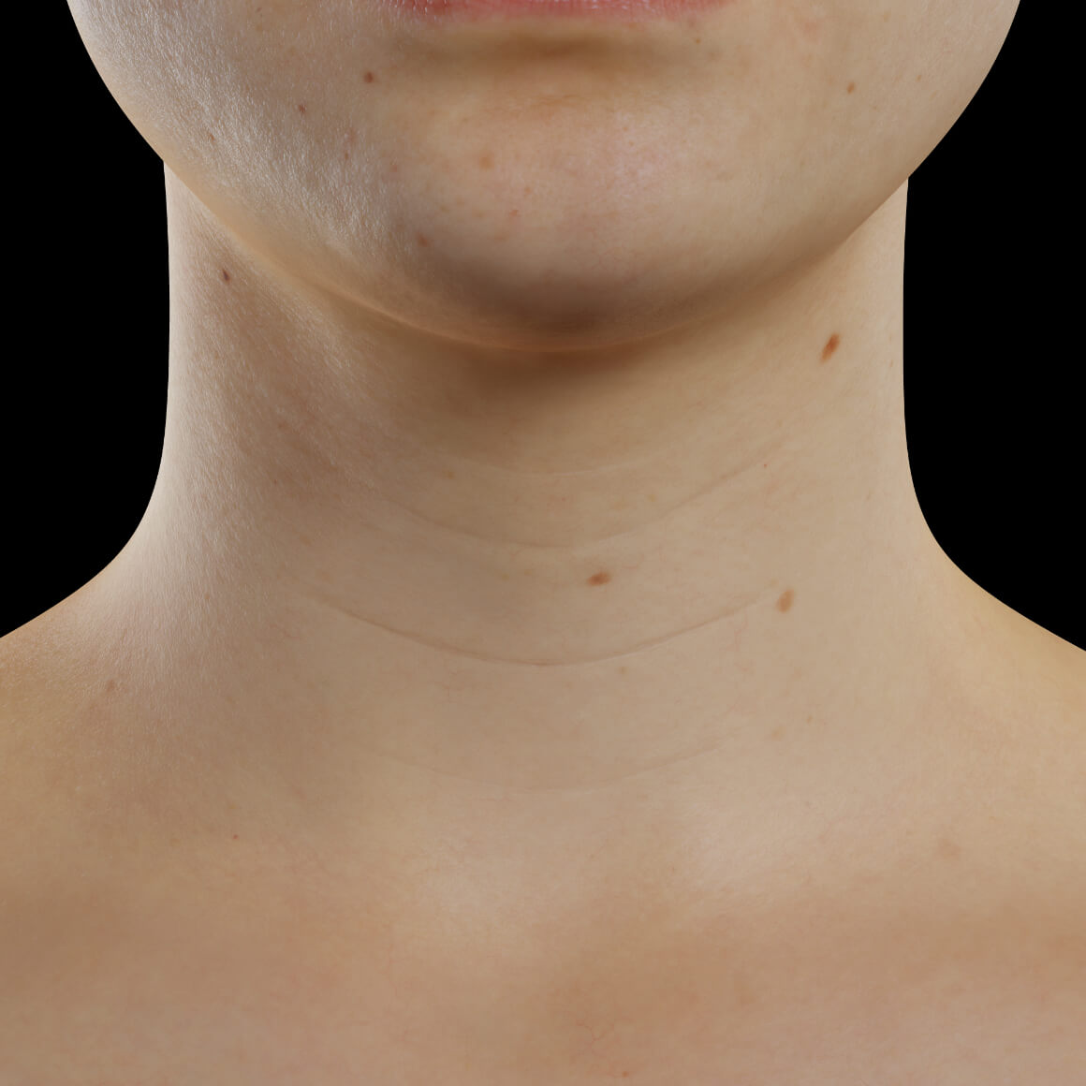
a neck
This is a neck.

Slide 28
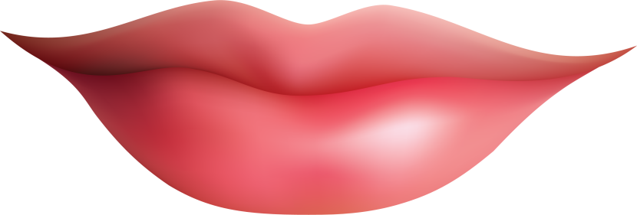
some lips
These are lips.

Slide 29
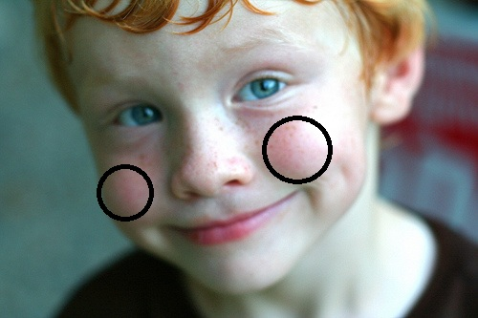
some cheeks
These are cheeks.

Slide 30
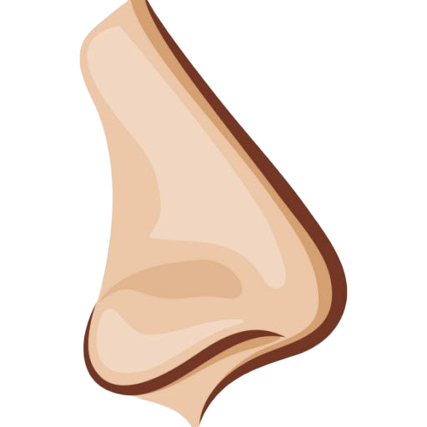
a nose
This is a nose.

Slide 31
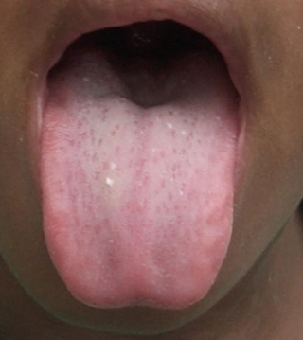
a tongue
This is a tongue.

Slide 32
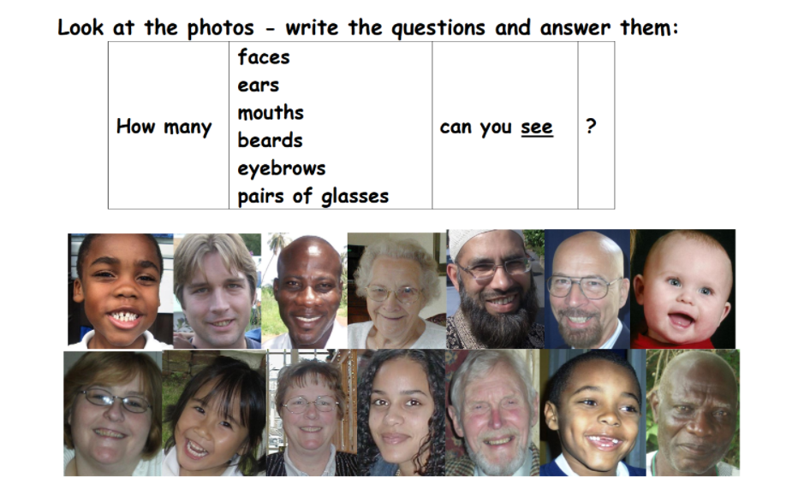
cheeks
I can see…

Slide 33
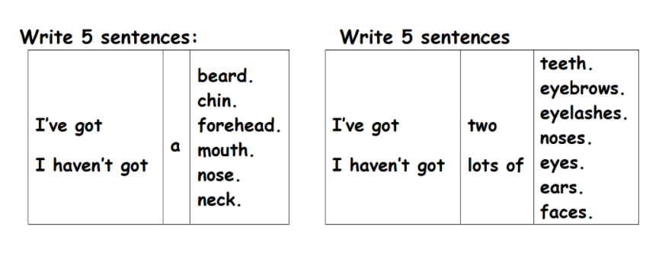
I’ve got a beard. I’ve got two eyes.
I haven’t got a beard. I haven’t got lots of noses.

